Slide 1
Introduction to Business Analysis Week commencing 29/04/2024
Unicom TIC
May 2024

Slide 2
Prerequisites
Attended the sessions on web development
Attempted to complete the related practical work
Understanding of the Learning Objectives
Identified Learning Outcomes and established whether they have been achieved

Slide 3
Learning Objectives
Able to identify the problems
Understand requirement gathering
Able to come up with the solution
Overall design to achieve the solution

Slide 4
Software Development Cycle
Planning (PM)
Business Analysis (BA)
Design (UI/UX)
Implementation (Coding/Developer testing)
Testing (QA)
Deployment (Cloud)
Maintenance (Bugs/Enhancements/Support)
Notes:
Web Content Accessibility Guidelines

Slide 5
Recap - Implementation (Coding/Developer testing)
Web Development
Web Hosting
Milestone 1:- HTML/CSS/Bootstrap/JavaScript
Milestone 2:- Front End
Millstone 3:- Back End

Slide 6
Recap - Best Practices
Responsive Design
Performance Optimisation
Scalability
Accessibility
Compliance
Security
Notes:
Web Content Accessibility Guidelines

Slide 7
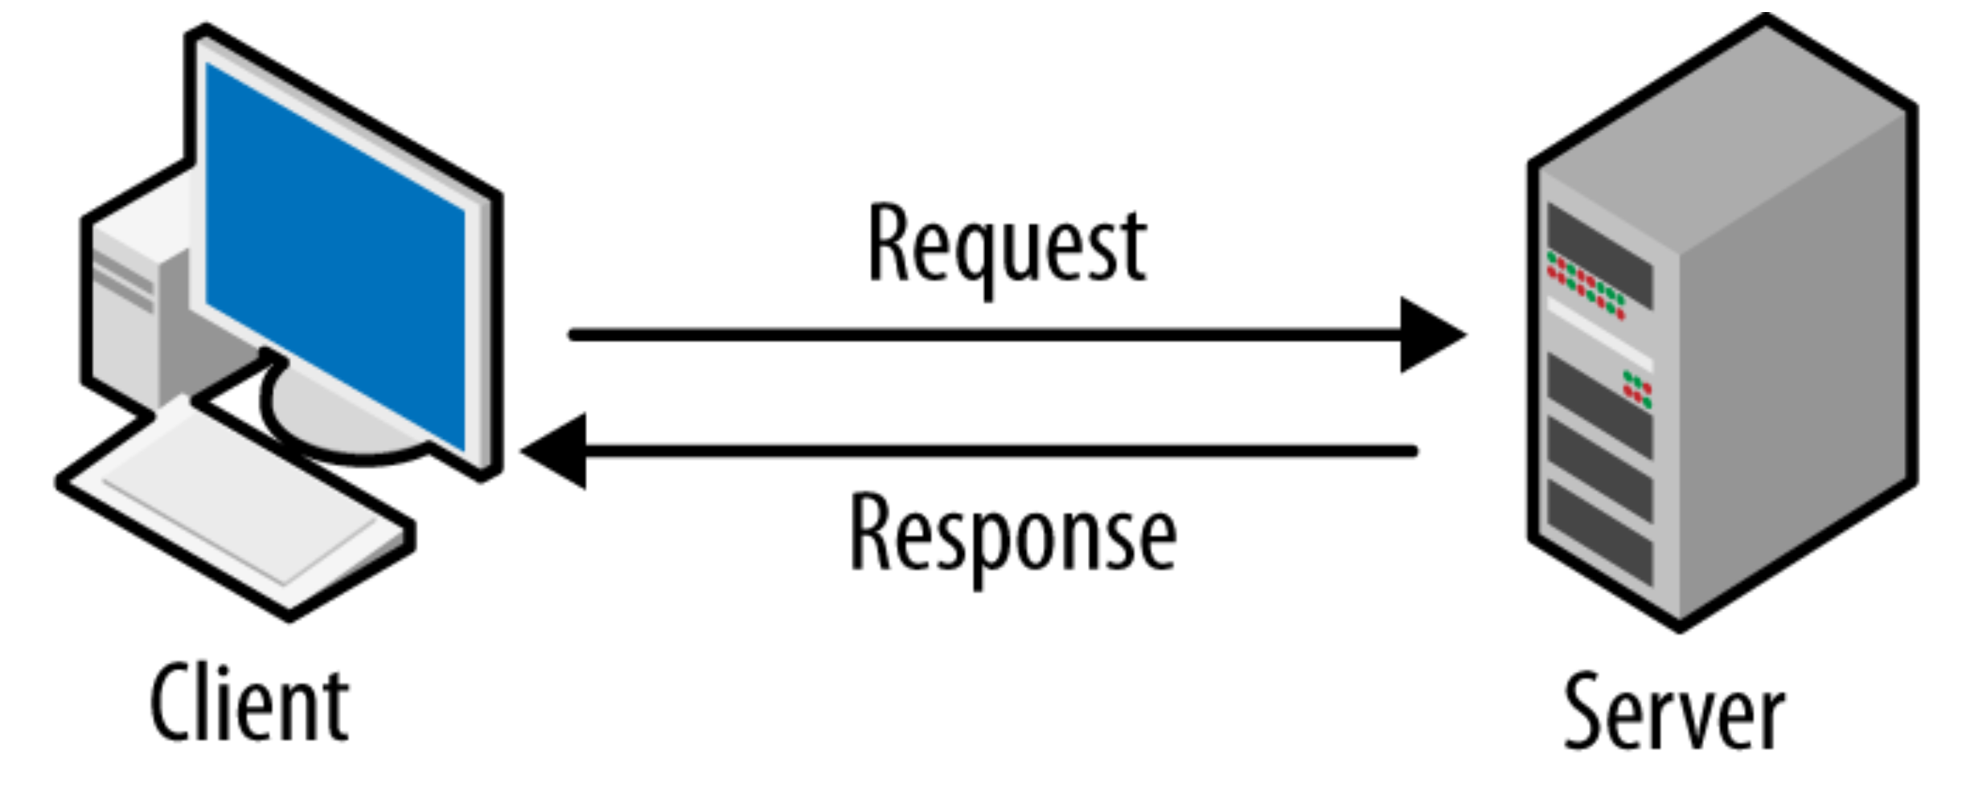
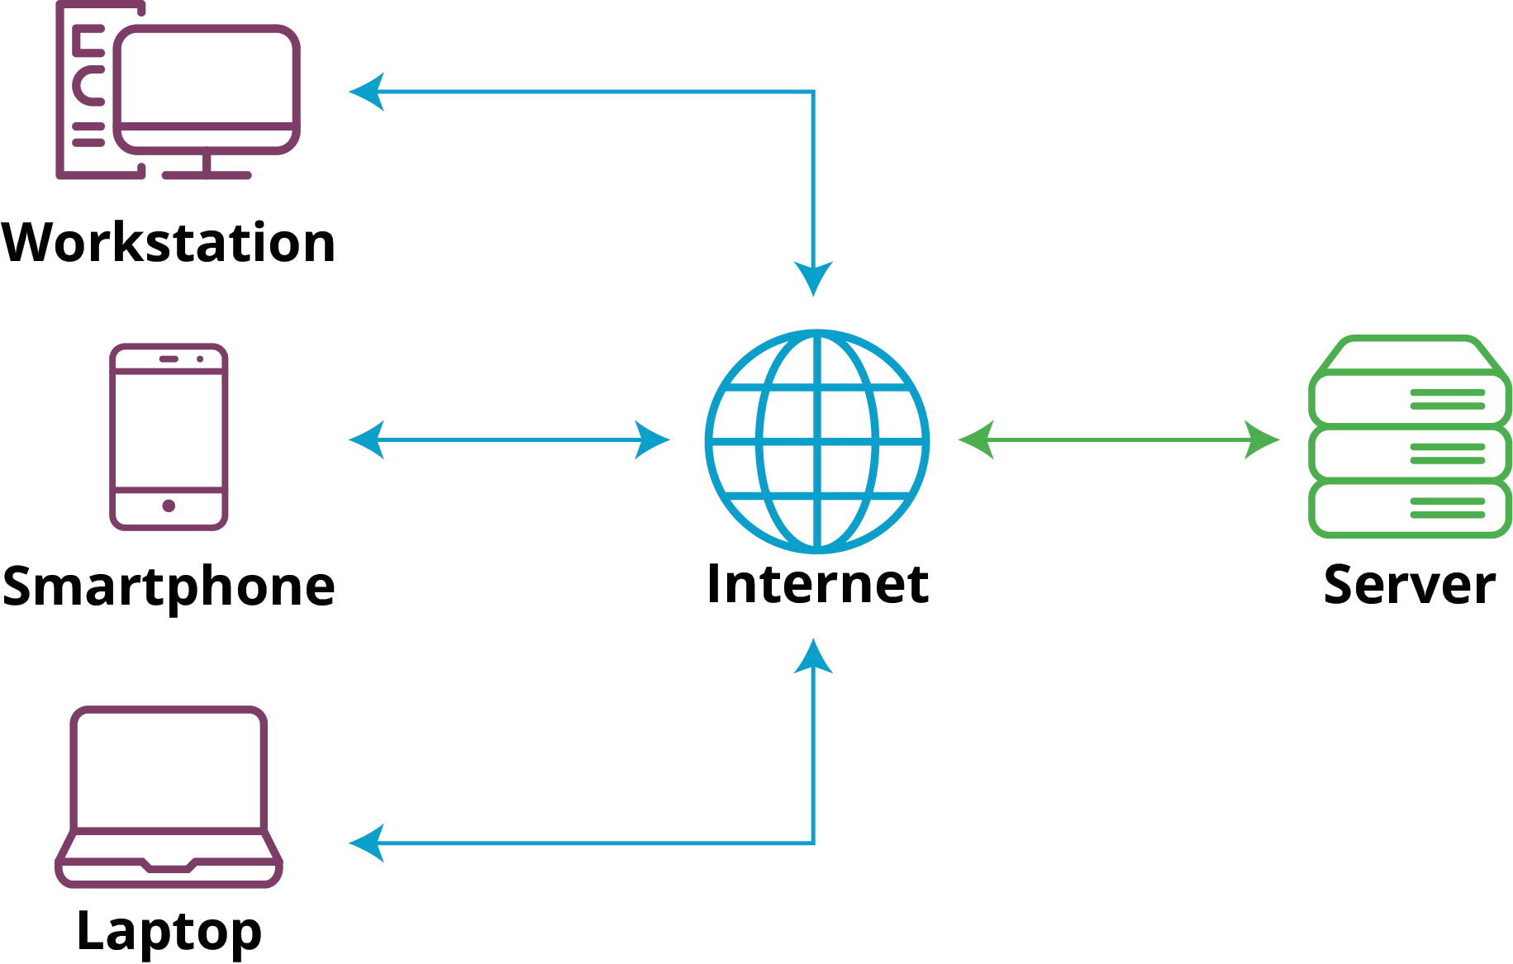
Recap - Client-Server Architecture
Notes:
Client: A client is typically a web browser (like Chrome, Firefox, Safari) or a mobile app that requests resources or services from a server.
Server: A server is a remote computer or system that stores data, processes requests, and delivers resources or services to clients.

Slide 8
Recap - What are the 3 major components of client-server architecture?
Presentation
Application logic
Data storage.

Slide 9

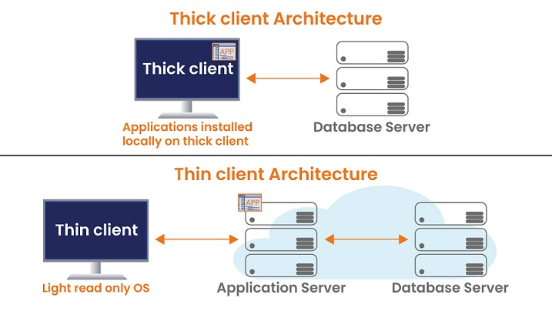
Recap - Thin client vs Thick Client

Slide 10
Software Development Cycle
Planning (PM)
Business Analysis (BA)
Design (UI/UX)
Implementation (Coding/Developer testing)
Testing (QA)
Deployment (Cloud)
Maintenance (Bugs/Enhancements/Support)
Notes:
Web Content Accessibility Guidelines

Slide 11
Purpose of Business Analysis (BA)
The purpose of business analysis is to identify business needs, problems, and opportunities and to recommend appropriate solutions and changes to address them.
Business analysis involves examining the structure, processes, and systems within an organisation to understand how it operates and how it can be improved to achieve its goals more effectively.
Notes:
Selecting a methodology to establish a framework in which the steps of software development are applied. It describes an overall work process or roadmap for the project. Methodologies can include Agile development, DevOps, Rapid Application Development (RAD), Scaled Agile Framework (SAFe), Waterfall, and others.
Gathering requirements to understand and document what is required by users and other stakeholders.
Choosing or building an architecture as the underlying structure within which the software will operate.
Developing a design around solutions to the problems presented by requirements, often involving process models and storyboards.
Building a model with a modeling tool that uses a modeling language like SysML or UML to conduct early validation, prototyping, and simulation of the design.
Constructing code in the appropriate programming language. Involves peer and team review to eliminate problems early and produce quality software faster.
Testing with pre-planned scenarios as part of software design and coding — and conducting performance testing to simulate load testing on the application.
Managing configuration and defects to understand all the software artifacts (requirements, design, code, test) and build distinct versions of the software. Establish quality assurance priorities and release criteria to address and track defects.
Deploying the software for use and responding to and resolving user problems.
Migrating data to the new or updated software from existing applications or data sources if necessary.
Managing and measuring the project to maintain quality and delivery over the application lifecycle, and to evaluate the development process with models such as the Capability Maturity Model (CMM)

Slide 12
1. Understanding Business Needs:
Business analysts work to understand the needs and objectives of a business or organisation.
This involves gathering requirements from stakeholders, including customers, employees, and management, to ensure that proposed solutions align with business goals.

Slide 13
2. Identifying Problems and Opportunities:
By analysing current processes and systems, business analysts can identify areas where inefficiencies exist or where opportunities for improvement or innovation may arise.
This could involve identifying bottlenecks in workflows, areas of high cost, or areas where customer satisfaction could be improved.

Slide 14
3. Developing Solutions:
Business analysts propose solutions to address identified needs, problems, and opportunities.
This could involve recommending changes to processes, implementing new technologies, or developing new products or services.

Slide 15
4. Facilitating Change Management:
Implementing changes within an organisation can be complex and challenging.
Business analysts help facilitate this process by working with stakeholders to understand their concerns, managing expectations, and helping to ensure that changes are effectively communicated and implemented.

Slide 16
Any Questions?

Slide 17
Let's have a go !!

